Slide 1

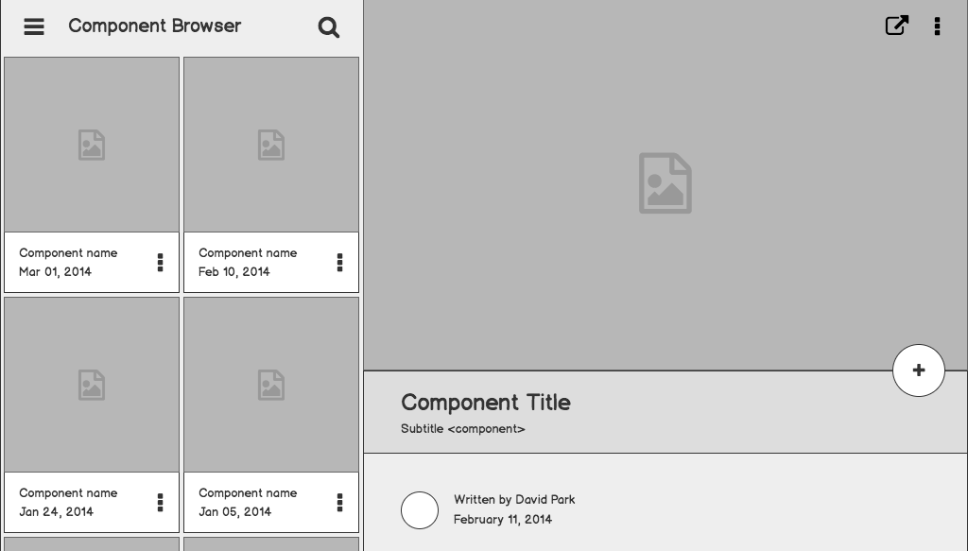

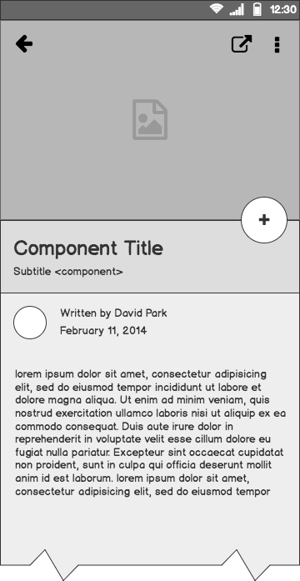
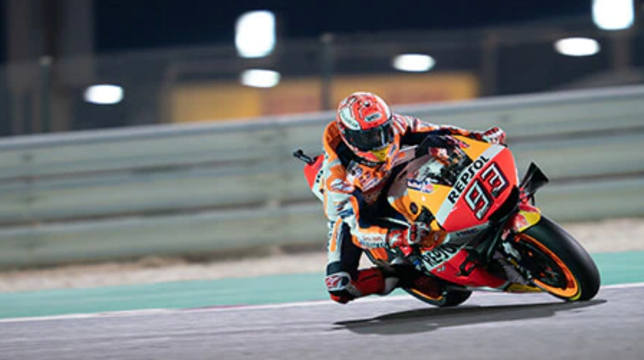
ABC RACING Case Study
Root Cause Analysis of Problem statement and solution proposal for front end architecture

Slide 2
Outline
The Problem & Root Cause Analysis
Opportunity For Solution Architecture
Tooling-Sitemap-Project Structure
Team, Innovative Ideas & Next Steps

Slide 3
The Problem

Slide 4
Problem statement & RCA
To increase the fan fare(old and new), by revamping their legacy digital presence in multiple geography as people are showing less interest in their sports.
Assumption: The old digital presence is based on legacy tech stacks and it doesn’t support the SPA architecture. Hence the application lacking in loading time, social interaction to the users, accessibility, caching ,offline viewing and localised content.

Slide 5
Opportunities for Improvement #What customers Digital Requirement Trend today
As per digital user feedbacks from time to time, The following audit parameters are required to improve the geolocation digital experience trend of site/app.
Performance Audit
PWA Audit
Best Practice Audit
Accessibility Audit
SSR & SEO Audit
Analytics Audit
Localisation
Security Enhancement

Slide 6

Supporting information
01-Performance
97%
Users are more engaged in a Highly performed site.
Important metrics to measure #
First Contentful Paint (FCP)
Largest Contentful Paint (LCP)
First Input Delay (FID)
Time to Interactive (TTI)
Total Blocking Time (TBT)
Cumulative Layout Shift (CLS)

Slide 7

Supporting information
02-PWA
80%
Users are constantly searching for a solution for Cached content in offline mode
Measure if your site is fast, reliable and installable.

Slide 8

Supporting information
03- Best Practices
82%
Improved health of sites are constantly comes under the search engine and hence find more users.
Improve code health of your web page following these best practices

Slide 9

Supporting information
04- Accessibility
95%
Users frequency increased if site is accessible.
Can all users access content and navigate your site effectively?

Slide 10

Supporting information
05-SEO
95%
Sites are ranks top if optimised for search engine. Hence user traffic increases.
How well can search engines understand your content?

Slide 11
Supporting information
06-SSR
95%
Site performance and SEO increased by the SSR integration.
Is all your page content served to the client Browser ?

Slide 12
Supporting information
07-Localisation
95%
Localised content help in SEO and Accessibility. Hence increases the user base.
Is all your page content served to the client Browser with different geolocation locales ?

Slide 13

Supporting information
08-Social Presence
95%
Sites present in social platforms increases the user by sharing and caring.
Is all your app/site available in multiple social platforms like facebook, twitter and all?

Slide 14

Supporting information
08-Security Measures
95%
Trusted sites attracts more user then a non-trusted site.
Is your app/site secure enough to trust your user?
Consider following measures - Preventing cross-site scripting (XSS) - Cross-site request forgery (CSRF) - Cross-site script inclusion (XSSI)

Slide 15
Opportunity for Solution Architecture Proposal

Slide 16
Solution description
As mentioned in root cause analysis, I would prefer to create a Cutting edge SPA architecture with Hybrid tech stack which is preferably enable with SSR, PWA for performance and user experience, Analytics to improve SEO integrations, support i18n - multi-lingual localised content for geolocation footprint with And also Routing for multi page navigation. The app should accessible to all users, scalable and extensible for the developers. It Should support offline viewing for users for the better user experience. In this solutioning the following aspect needs to be take care of the following principles of architecture-
DRY- Don’t Repeat Yourself
KISS - Keep It Simple Stupid
SOLID Principle

Slide 17
Solution description Conted..
The five SOLID principles are:
Single responsibility principle: a class should have one, and only one, reason to change
Open-closed principle: it should be possible to extend the behavior of a class without modifying it.
Liskov Substitution principle: subclasses should be substitutable for their superclasses
Interface segregation principle: many small, client-specific interfaces are better than one general purpose interface.
Dependency inversion principle: depends on abstractions not concretions

Slide 18
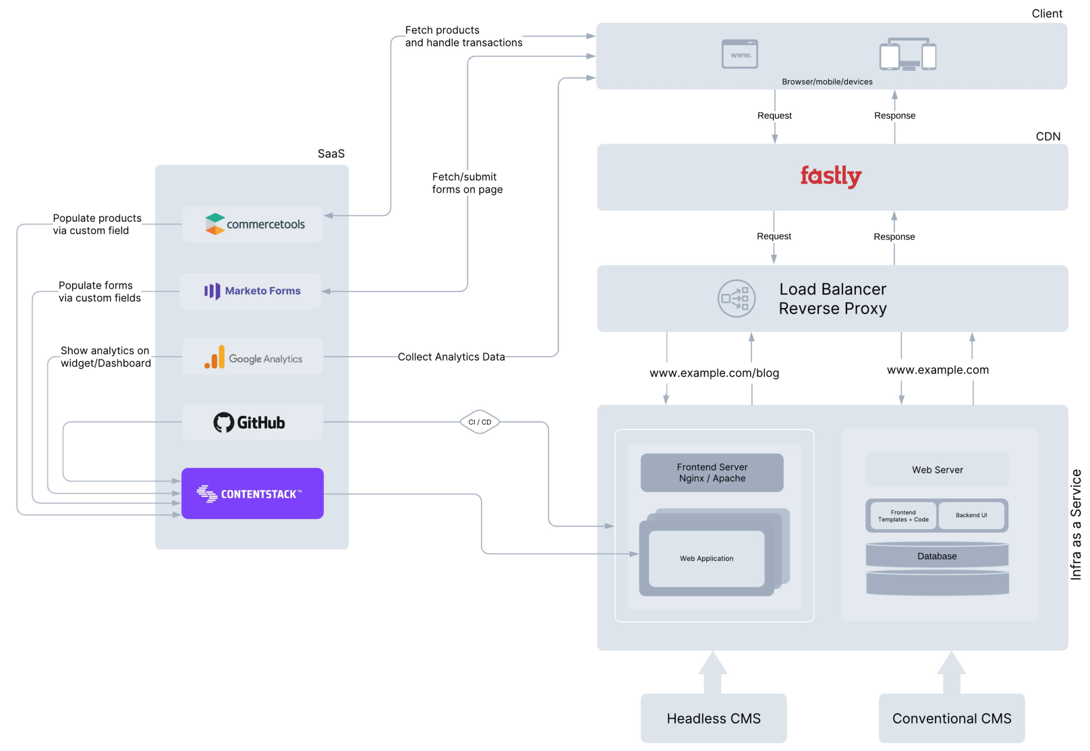
Why it’s better than existing solutions
Sprout Social Buffer
Jenkin | Bitbucket | Junit | SonarQube |….
Web Application Powered By
Client Side App ←→ Server Side App

Slide 19
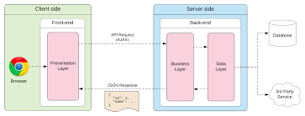
Why it’s better than existing solutions...
Presentation Layer Powered By
Single Page Application

Slide 20
Why it’s better than existing solutions...
Single Page Application
Client Side
UI Layer HTML/CSS/JS
Business Logic/ Application Layer JS
Data Access Layer JS
Offline Storage
Rest API
Server Side
Business Logic Layer
Data Services

Slide 21
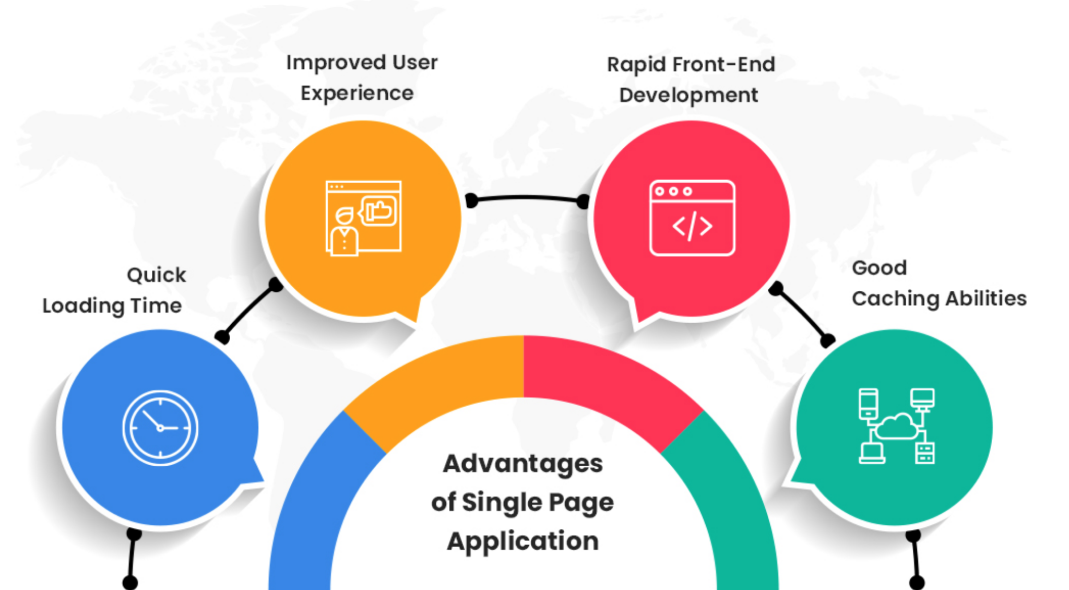
Why it’s better than existing solutions...
Benefits of Single Page Application

Slide 22
SPA Tooling | Site map | Project Structure

Slide 23
SPA Tools
Angular/React/Vue
ANGULAR ECOSYSTEM BASED ON TYPESCRIPT
1. Page Navigation Angular Routing Module
2. SSR Angular Universal Module
3. PWA Angular PWA Module
ng add @nguniversal/express-engine
8. Ang Security XSS | CSRF | XSSI
ng add @angular/pwa
4. Localisation i18n Module [ngx-translate]
Dom Sanitisation Trusted Values CSP
5. Analytics - Google Angulartics2 Library Module
6. Testing [Unit | e2e] [Karma & Jasmine | Protractor]
7. Graceful Degradation [Polyfills for Legacy Browsers IE8...]

Slide 24
ABC RACING - Module, Component Mapping
@Core Module Singleton Services (seo, )
Angular Module & Component Mapping
Angulartics2 Module Angulartics2GoogleAnalytics
APP MODULE
Auth Module
Localisation Module i18n Module [ngx-translate]
Feature Module - Home Home Page Components
Feature Module -About About Page Components
Shell Module - PWA Comps: Shell | Header | Footer | Social
@Shared Module Http interceptor | logger Service| Loader and Common UI Components

Slide 25
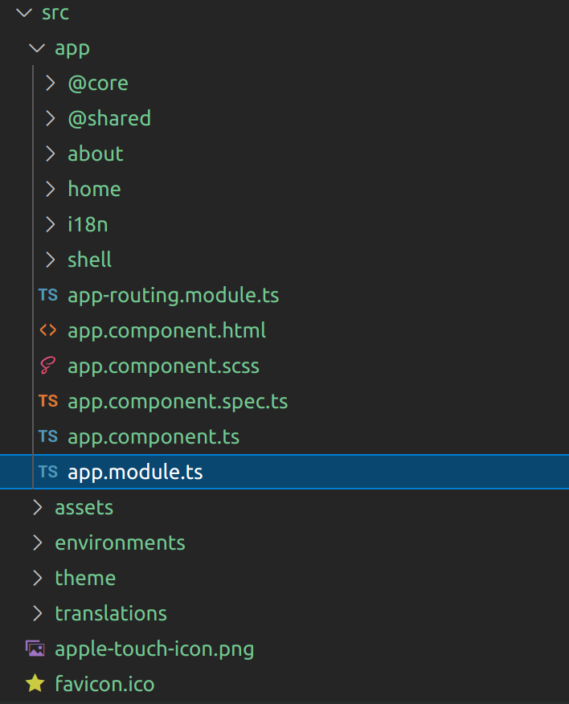
ABC RACING - Project Structure
Angular Project Folder Structure

Slide 26

Information architecture
Login
Home
About
Racing Events
Polling
News

Slide 27
Code Standard, Performance, Accessibility Measure tools
TSLinting, SonarQube integration in CI/CD, Style linting
Chrome lighthouse [Performance and accessibility, SEO and PWA ]
Pa11Y for accessibility,
Screen readers - JAW, VoiceOver(MAC), TalkBack(Android)
Firefox YSlow and others

Slide 28
Team | Innovative Ideas | Next Steps

Slide 29
TEAM
Onshore
Offshore
2 Member
1 Member
2 Member
3 Member
2 Member
PM
SCRUMB MASTER
QA
DEVOPs Eng
FED & Backend ARCHITECT
FED TEAM
BED TEAM

Slide 30
Innovation and What next?
Add Online Gaming for Better User Engagement
Add Social engineering tool for enhance user base.
Periodically brainstorming in team for getting new ideas for improvement and enhancement.
And Many more ideas to come

Slide 31
Questions & Feedback?

